Slide 1
RNN
LSTM
GRU

Slide 2
RNN ( recurrent NN )
Great for modeling sequential data.
Eg of sequential data - speech, audio, text etc
Use cases - speech recognition, language translation, stock prediction etc
Notes:
R => Recurrent (Recursive or repetitive )
N => Neural
N => Network

Slide 3
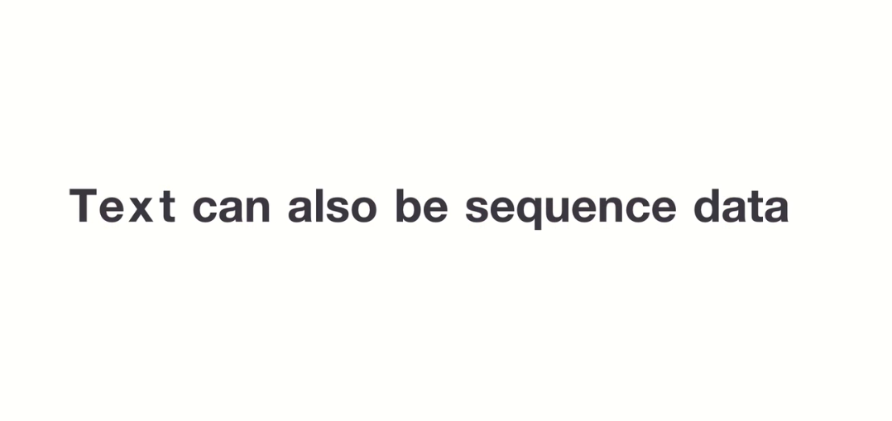

Slide 4
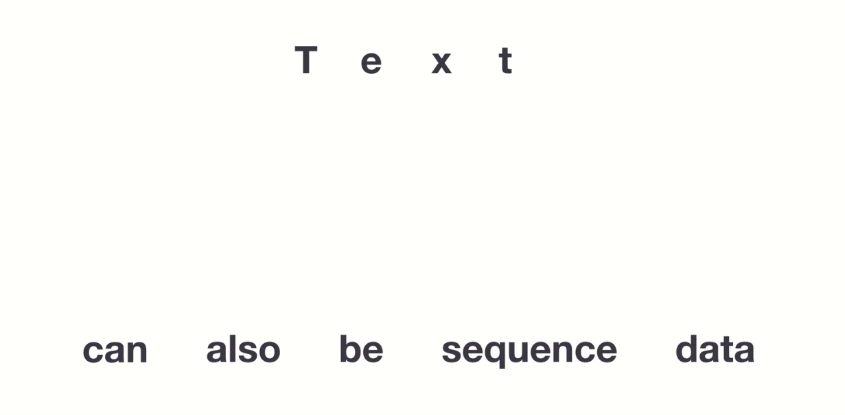

Slide 5
Example of a sequential memory

Slide 6
A B C D E F G H I J K L M N O P Q R S T U V W X Y Z

Slide 7
Z Y X W V U T S R Q P O N M L K J I H G F E D C B A

Slide 8
H I J K L M N O P Q R S T U V W X Y Z

Slide 9
THAT MEANS SEQ. DATA IS EASIER TO REMEMBER!
& RNNs ARE ABSTRACT CONCEPT OF SEQ. MEMORY

Slide 10
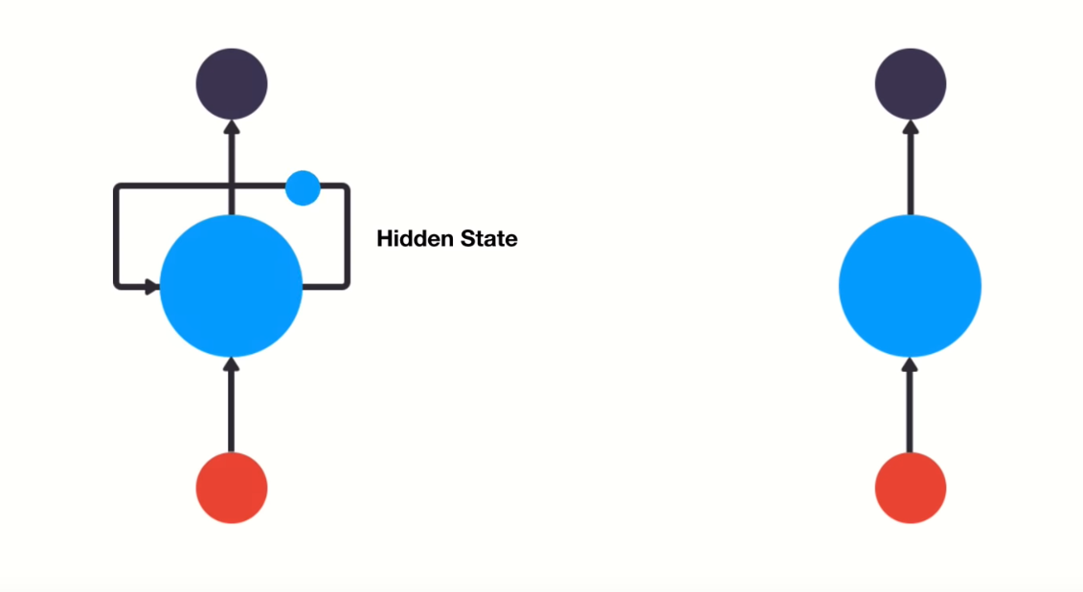

Slide 11

CHATBOT EXAMPLE
YOU: WHAT TIME IS IT ?
ASKING FOR TIME ….

Slide 12
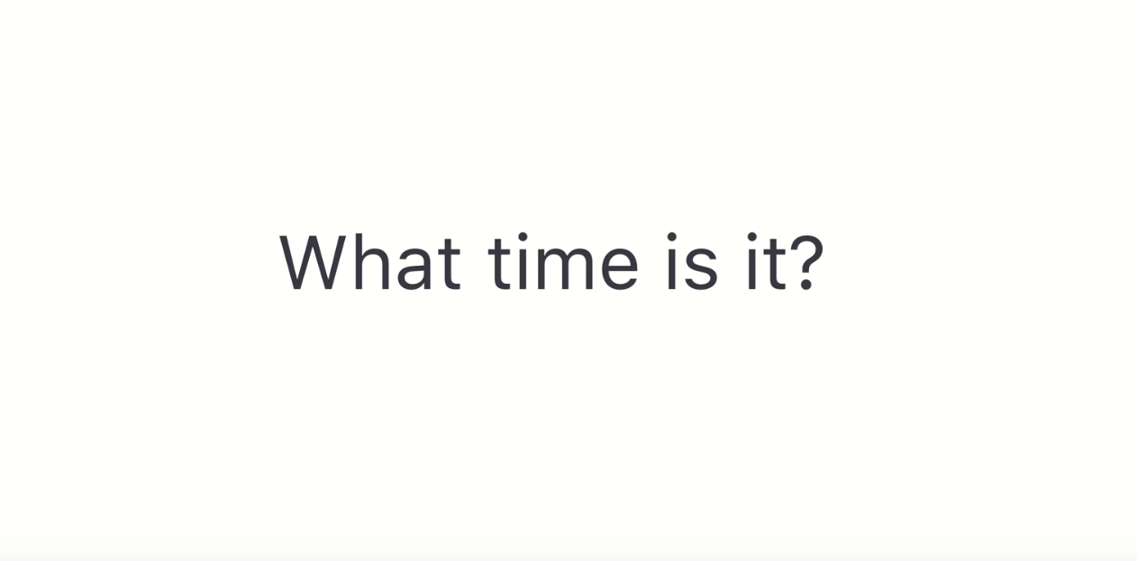

Slide 13
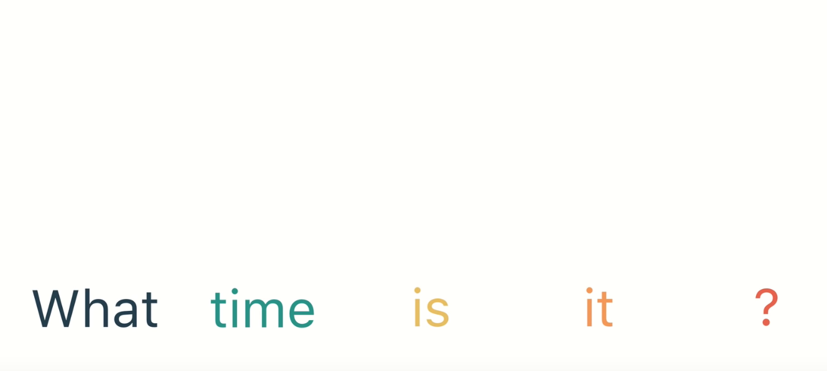

Slide 17
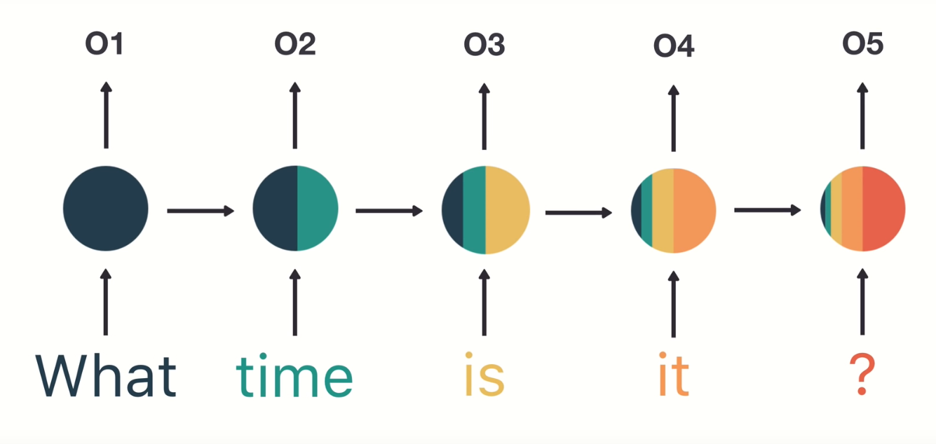

Slide 18
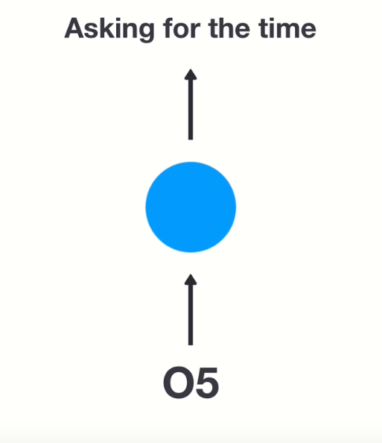
h1
h2
h3
h4
FFNN

Slide 19
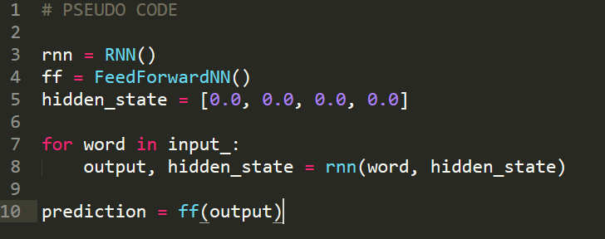

Slide 20
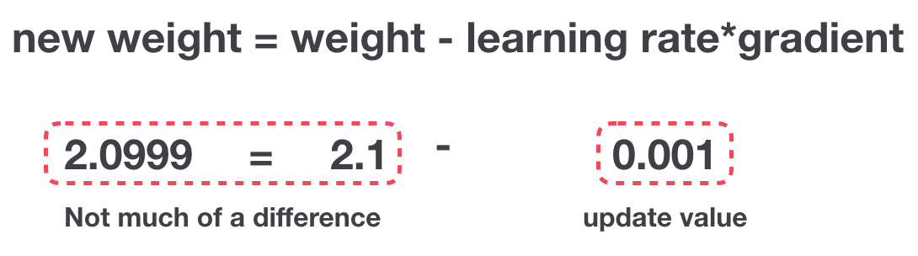
RNNs suffer from vanishing gradient hence they have short term memory.

Slide 21
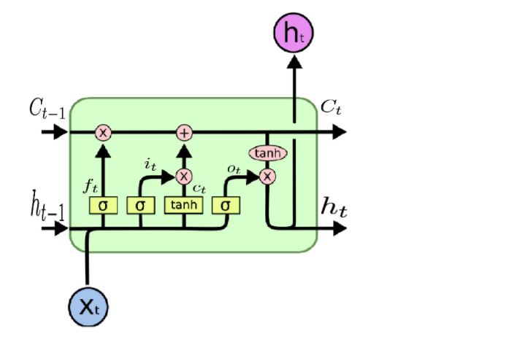
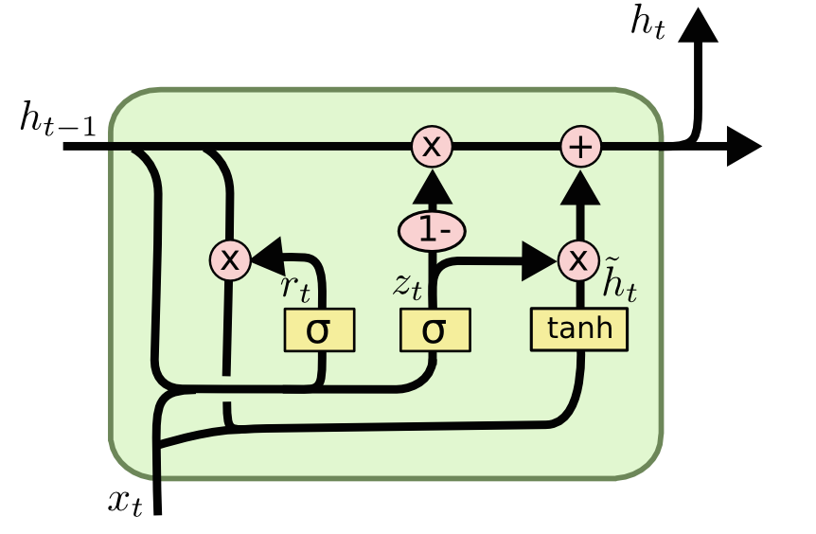
LSTM and GRU ( comes to rescue to tackle short term memory issue )

Slide 22
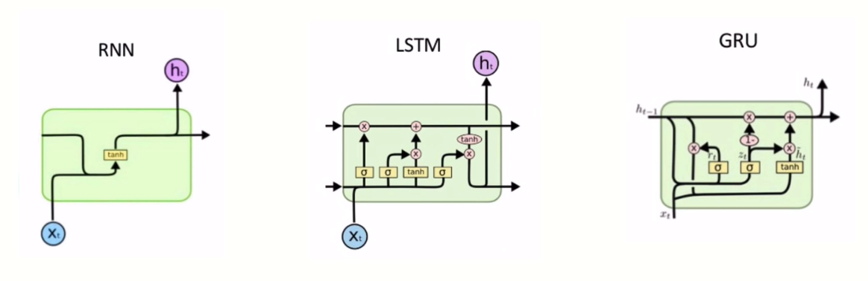
Simple arch.
Good for speed as it has less tensor ops.
Suffers short term memory.
Quite complex.
Good for modeling longer sequences which has long term dependencies.
Conquers short term memory.

Slide 23
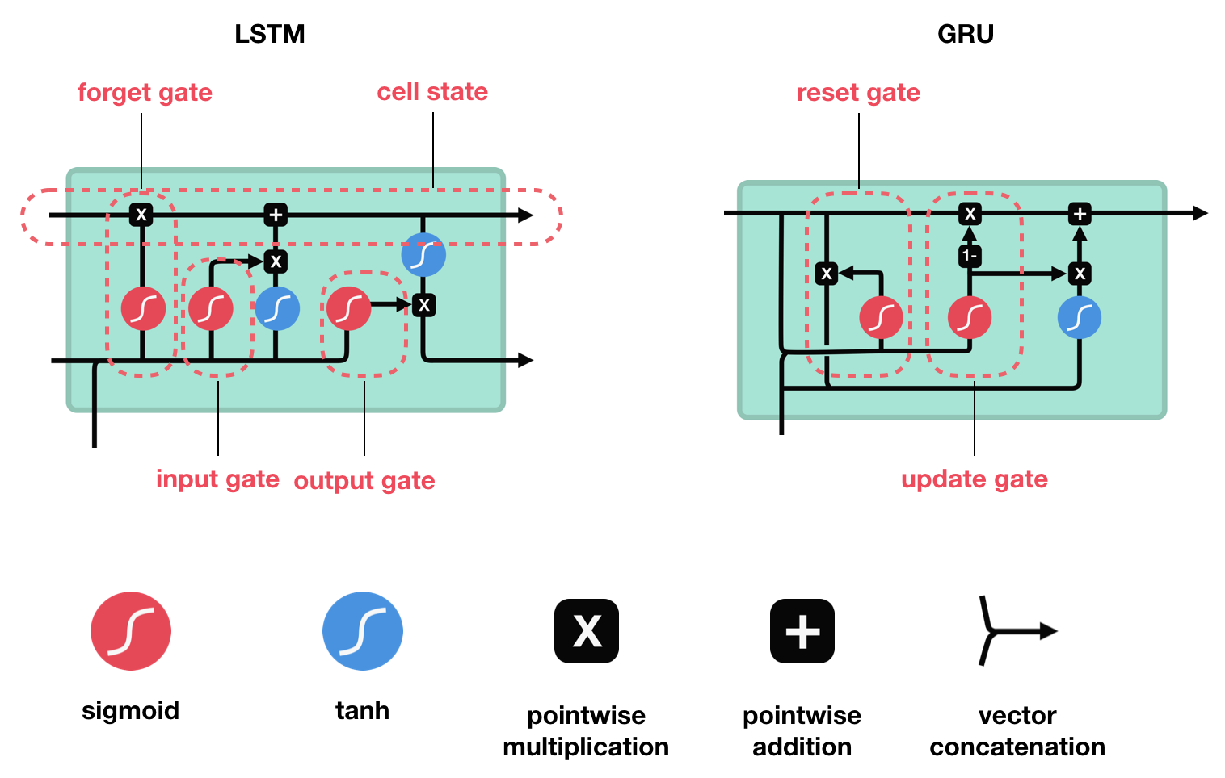

Slide 24
USE cases -
Speech recognition
Generating caption for a pic
Text generation

Slide 25
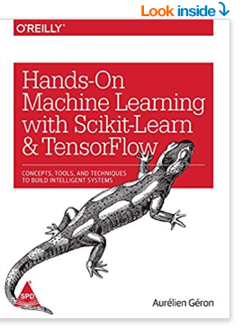
Customer review example-
5.0 out of 5 stars
A perfect book for ML Scikit and Tensorflow
This is one of the best books you can get for someone who is just starting out in ML, in its libraries such as Tensorflow, It covers the basics very good. As a book, it is 5/5

Slide 26
Customer review example-
5.0 out of 5 stars
A perfect book for ML Scikit and Tensorflow
This is one of the best books you can get for someone who is just starting out in ML, in its libraries such as Tensorflow, It covers the basics very good. As a book, it is 5/5

Slide 27
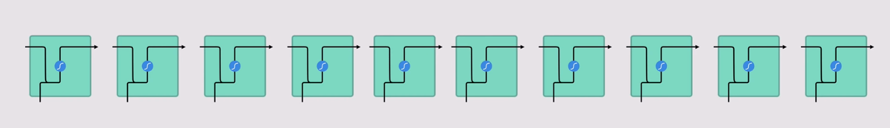
perfect book for ML Scikit and Tensorflow This is one

Slide 30
Tanh function and Sigmoid function

Slide 34
Forget gate

Slide 35
Input Gate

Slide 36
Cell State

Slide 37
Output Gate

Slide 38
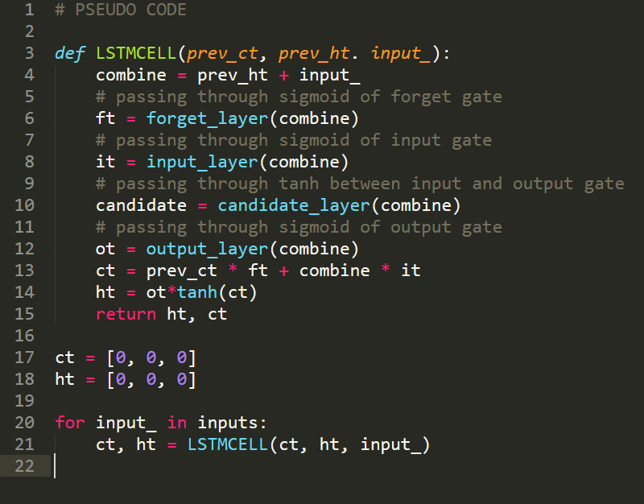

Slide 39
Notes:
1- => 1-data

Slide 40
References -
http://colah.github.io/posts/2015-08-Understanding-LSTMs/
https://towardsdatascience.com/illustrated-guide-to-lstms-and-gru-s-a-step-by-step-explanation-44e9eb85bf21
https://towardsdatascience.com/illustrated-guide-to-recurrent-neural-networks-79e5eb8049c9

